Slide 1

Presented By: Batch-15 M.Akshaya(247R1A05W4) M.Abhiram(247R1A05V8) Shiven.K(247R1A05Y2)
STUDENT PERFORMANCE PREDICTOR & TRACKER
Under the Guidance of: V. Hari Hara Nadha Sai (Assistant Professor)

Slide 2
Abstract:
The Student Performance Predictor and Tracker is a data-driven system designed to analyze and predict students’ academic performance using advanced data analytics and machine learning techniques. It examines various academic factors such as marks, attendance, classroom participation, and other related data to understand learning patterns and trends in student performance.By analyzing historical and real-time student data, the system can identify students who may be at risk of poor academic performance. This early prediction allows educators to take timely action and implement effective strategies to support students who need additional academic guidance.The system also includes real-time monitoring and tracking features that allow teachers to continuously observe student progress, engagement, and improvement. This helps educators better understand each student's learning behavior and adjust their teaching methods accordingly.Overall, the Student Performance Predictor and Tracker helps educational institutions make informed, data-driven decisions. It supports personalized learning, improves academic outcomes, and creates a more supportive educational environment where every student has a better opportunity to succeed.

Slide 3
Existing System:
Many current systems rely only on basic data such as grades and attendance, which gives a limited view of student performance and makes it difficult to identify important patterns or trends that affect student success.
Most tools focus on analyzing past academic results instead of predicting future outcomes. This reactive approach delays the identification of at-risk students and prevents educators from providing timely support and interventions.
Many systems depend on manual data entry and simple analysis methods, which can lead to errors and inconsistencies. Additionally, they do not use advanced analytics or machine learning techniques that could improve prediction accuracy and provide deeper insights.
Many existing systems do not effectively track students’ learning behavior, engagement, or real-time academic activities. Because of this, educators lack continuous monitoring tools to understand student progress and provide personalized guidance throughout the learning process.

Slide 4
Disadvantages of Existing System:
Limited prediction ability – Most systems only analyze past results and cannot accurately predict future student performance.
No real-time data monitoring – They do not provide real-time updates on student engagement and academic progress.
Manual data entry – Many systems depend on manual data collection, which can cause errors and increase workload for teachers.
Inaccurate identification of students – Some systems may wrongly identify students as at-risk, which can lead to unnecessary attention and wasted resources.
Lack of integrated data – Existing systems often do not combine different factors like attendance, background, and activities, limiting a complete understanding of student performance.

Slide 5
Proposed System:
The proposed system collects and integrates different types of student data such as marks, attendance, participation, extracurricular activities, and other academic factors to provide a complete and detailed understanding of student performance.
It uses data analytics and machine learning techniques to analyze historical student data and predict future academic performance, helping educators understand performance trends and patterns.
The system helps identify students who may be at risk of poor academic performance at an early stage, allowing teachers to provide timely support, guidance, and necessary interventions.
It provides real-time monitoring of student attendance, engagement, and academic progress so that educators can continuously track and evaluate student performance.
The platform offers an easy-to-use interface with dashboards, reports, and alerts that help teachers and administrators make better data-driven decisions to improve overall student learning outcomes.

Slide 6
Advantages of Proposed System:
Enhanced Prediction Accuracy: The system uses advanced data analytics and machine learning techniques to predict student academic performance more accurately.
Real-Time Monitoring: It allows teachers to track student attendance, engagement, and academic progress in real time, helping them take quick action when problems occur.
Comprehensive Data Integration: The system combines different types of student data such as marks, attendance, and other factors to provide a complete view of student performance.
Personalized Learning Support: By analyzing individual learning patterns, the system helps teachers provide personalized guidance and support to students.
User-Friendly Interface: The platform provides an easy-to-use dashboard with reports and visualizations, making it simple for educators to understand student performance and make better decisions.

Slide 7
Hardware Requirements:
SYSTEM REQUIREMENTS
System : Pentium IV 2.4 GHz.
Hard Disk : 40 GB.
Ram : 512 Mb.
Software Requirments:
Operating system : Windows.
Coding Language : python.

Slide 8
Novelty:
The project introduces a machine learning–based prediction system that analyzes student data such as marks, attendance, and assignment submissions to determine the academic risk level of each student. This helps in identifying students who may face learning difficulties in the future.
The system automatically detects students who are at high academic risk and sends email alerts to notify concerned users. This feature enables early intervention so that teachers can provide timely guidance and support to improve student performance.
The platform continuously monitors important academic factors such as attendance, marks, and assignment submissions to provide a real-time view of student progress. This helps educators track performance trends and take quick action when necessary.
The project integrates multiple academic management features such as study material sharing, assignment management, attendance tracking, messaging between students and faculty, and performance analysis in a single system, making it a complete student performance monitoring platform.

Slide 9
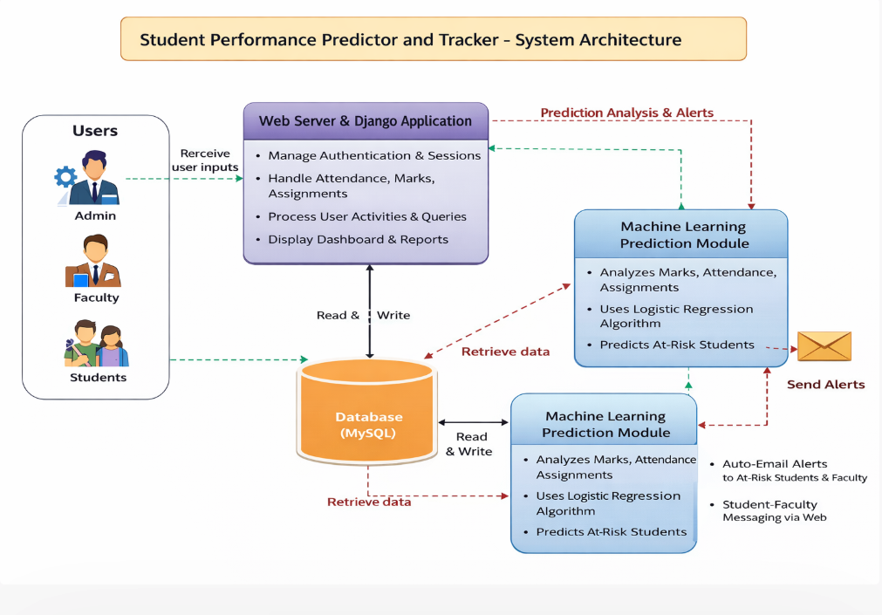
Architecture:

Slide 10
Modules:
Admin Module The admin manages the system by adding faculty and students, viewing details, and monitoring overall student performance.
Faculty Module Faculty members can add student marks, record attendance, create assignments, upload study materials, and communicate with students.
Student Module Students can view their marks, check assignments, download study materials, send messages to faculty, and track their academic progress.
Attendance and Marks Management Module This module records student attendance and marks, helping faculty maintain accurate academic records.
Student Performance Prediction Module This module uses machine learning to analyze student data such as marks, attendance, and assignments to predict academic risk levels.
Notification and Messaging Module The system allows communication between students and faculty and sends alerts when a student is identified as academically at risk.

Slide 11
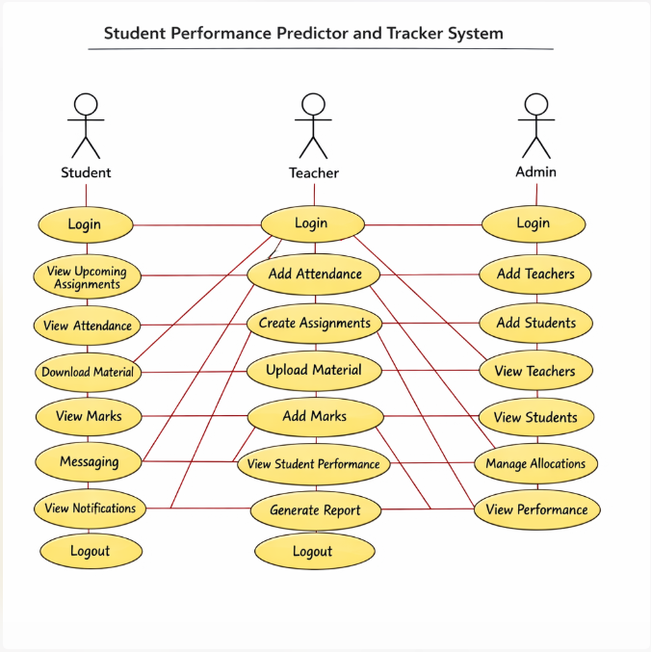
UML Diagrams:
Use Case Diagram:

Slide 12
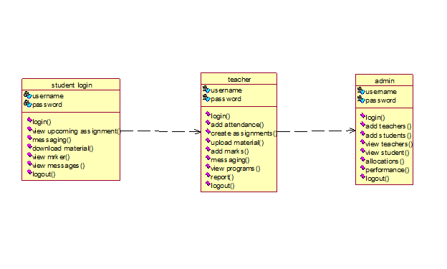
Class Diagram:

Slide 13
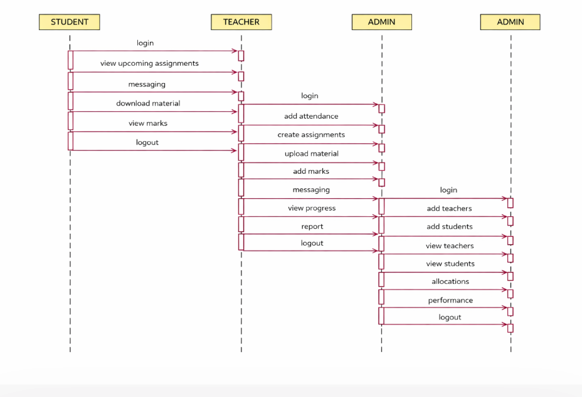


Sequence Diagram:

Slide 14
SOURCE CODE
from django.shortcuts import render
from django.http import HttpResponse
import pymysql
from datetime import datetime
def db():
return pymysql.connect(host='127.0.0.1',user='root',password='',database='studentapp')
def StudentLoginAction(request):
u,p=request.POST['t1'],request.POST['t2']
c=db().cursor()
c.execute("SELECT * FROM student WHERE username=%s AND password=%s",(u,p))
if c.fetchone():
request.session['uname']=u
return render(request,'StudentScreen.html',{'data':'Welcome '+u})
return render(request,'StudentLogin.html')
def FacultyLoginAction(request):
u,p=request.POST['t1'],request.POST['t2']
c=db().cursor()
c.execute("SELECT * FROM faculty WHERE username=%s AND password=%s",(u,p))
if c.fetchone():
request.session['uname']=u
return render(request,'FacultyScreen.html')
return render(request,'FacultyLogin.html')
def AdminLoginAction(request):
if request.POST['t1']=='admin' and request.POST['t2']=='admin':
return render(request,'AdminScreen.html')

Slide 15
def ViewMarksAction(request):
u=request.session.get('uname')
c=db().cursor()
c.execute("SELECT subject_name,subject_marks FROM marks WHERE student_name=%s",(u,))
rows=c.fetchall()
total=sum(r[1] for r in rows)
avg=total/len(rows) if rows else 0
return render(request,'StudentScreen.html',{'data':avg})
def AddMarksAction(request):
u=request.session.get('uname')
d=(request.POST['sname'],u,request.POST['t1'],datetime.now())
c=db().cursor()
c.execute("INSERT INTO marks VALUES(%s,%s,%s,%s)",d)
c.connection.commit()
def SendMessage(request):
u=request.session.get('uname')
d=(u,request.POST['sname'],request.POST['t1'],request.POST['t2'],datetime.now())
c=db().cursor()
c.execute("INSERT INTO messages VALUES(%s,%s,%s,%s,%s)",d)
c.connection.commit()
def index(request):
return render(request,'index.html')

Slide 16
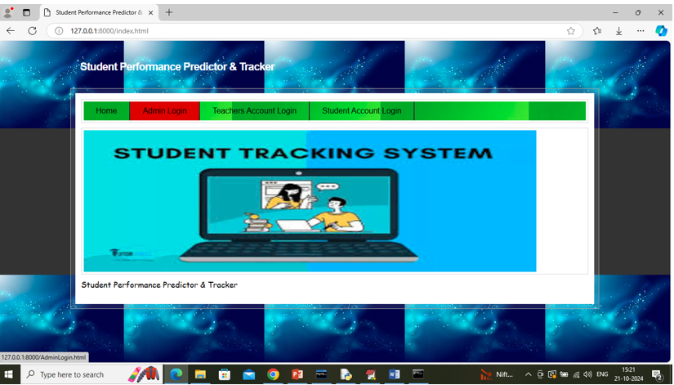
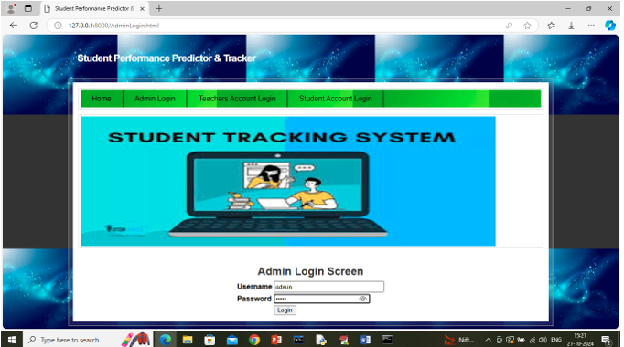
RESULTS

Slide 17
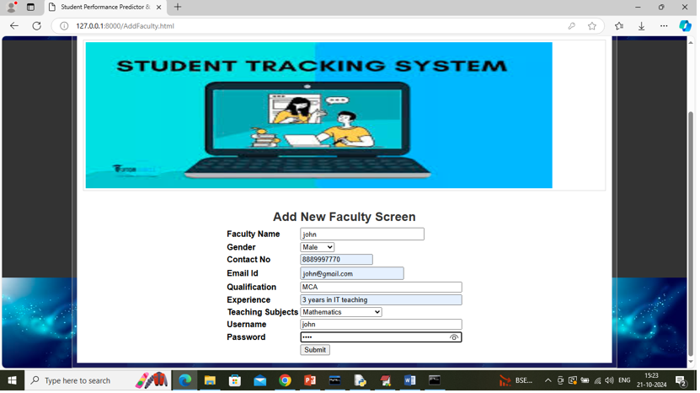
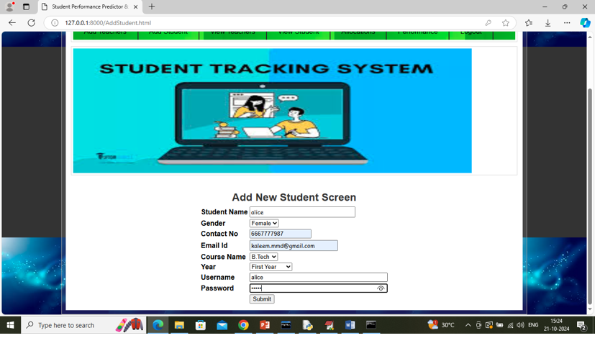

Slide 18
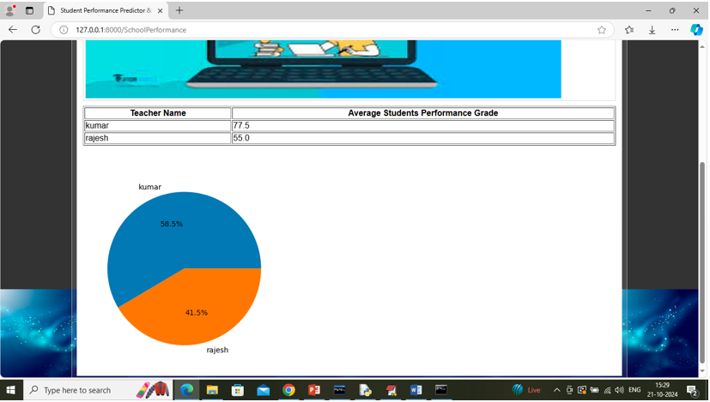
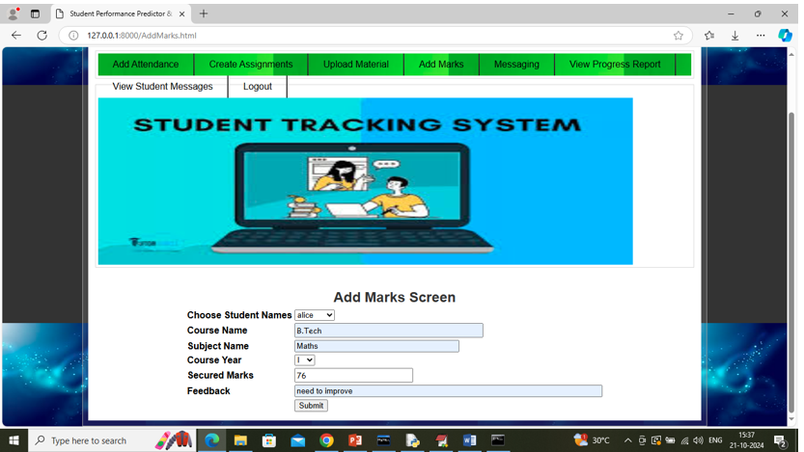

Slide 19
Conclusion:
The Student Performance Predictor provides a data-driven solution for analyzing and predicting student academic performance using factors such as marks, attendance, and other related data. By applying machine learning techniques, the system helps educational institutions identify students who may be at risk of poor performance at an early stage. This allows teachers and administrators to take timely actions and provide proper academic support.The system also helps educators understand performance patterns and make better decisions to improve teaching strategies and learning outcomes. In the future, the model can be further improved by integrating advanced technologies such as deep learning, real-time monitoring, and AI-based learning recommendations.Overall, this system can support educational institutions in improving student success rates, reducing dropout risks, and promoting a more effective and data-driven learning environment.

Slide 20
FUTURE ENHANCEMENT
The Student Performance Predictor and Tracker system can be enhanced by integrating real-time data from student records such as attendance, marks, and online learning platforms. This will help in providing more accurate and up-to-date predictions. The use of advanced machine learning and deep learning techniques can further improve prediction accuracy by identifying complex patterns and relationships in student data. Expanding the dataset and improving data quality can also make the system more reliable and effective.
The system can be extended to provide personalized learning recommendations based on individual student performance, helping teachers adjust their teaching strategies. It can also generate automatic alerts to identify at-risk students, enabling timely intervention and support. In the future, the system can be developed as a mobile or cloud-based application for easy access by students, teachers, and parents. Adding features like student engagement analysis and ensuring fairness in predictions will further improve the overall performance and usefulness of the system.

Slide 21
References:
Ahmed, W., Wani, M. A., Plawiak, P., Meshoul, S., & Hammad, M. (2025). Machine learning-based academic performance prediction with explainability. Scientific Reports, 15, 26879.
Gul, M. N., Abbasi, W., & Wani, M. Y. (2025). Machine learning mechanism for predicting student performance. Journal of Electrical Systems and Information Technology, 12, 32.
Wang, C., & Yao, S. (2025). Enhancing student dropout and academic success prediction using machine learning. ICCK Transactions on Educational Data Mining, 1(1), 36–43.
Zhang, H., Ren, Y., Nurius, P. S., Mankoff, J., & Dey, A. K. (2025). Early prediction models for academic performance. arXiv preprint arXiv:2504.12236.
Tiwari, M., & Jain, N. (2024). Student performance prediction using machine learning algorithms. ShodhKosh Journal, 5(6), 1112–1122.
ang, B., Li, S., & Zhao, C. (2024). Predicting student performance using deep ensemble learning. Journal of Intelligence, 12(12), 124.
Zhu, X. (2024). Prediction and analysis of university student performance using machine learning. Academic Journal of Computing & Information Science, 7(8), 79–86.
Al-Sarem, M., Saeed, F., Al-Hadhrami, T., & Boulila, W. (2023). Intelligent system for predicting student performance using ML algorithms. Baghdad Science Journal, 21(12), 3877–3891.
Waheed, H., Hassan, S., Aljohani, N., & Hardman, J. (2022). Predicting student performance using educational data mining. Computers & Education, 168, 104–115.
Albreiki, B., Zaki, N., & Alashwal, H. (2021). Student performance prediction using machine learning techniques: A review. Education Sciences, 11(9), 552.

Slide 22
GIT HUB LINK
https://github.com/akshayamogili06-ship-it/student-performance-and-tracker

Slide 23
Thank you!!

